Slide 1

Regression Problem
Module 6CM521: Frontiers in AI and Data Science
Ioannis Tsioulis (MC)
Slides acknowledgements:
Dr Aaisha Makkar

Slide 2
Declaration
The content of the slides are modified based on:
  The book “Doing Data Science”
  The Stanford ML course http://www.ml-class.org/
  Some other references
Acknowledgement
Most of the slides are adapted from the lecture slides of Dr Hong Qing Yu (Harry).

Slide 3
Outlook
Linear regression
  Examples
  Math notation
  Least Mean Square function (LMS)
  Gradient Descent function
Logistic regression

Slide 4
What is linear regression
Linear regression is a commonly used statistic based predictive model to exam the relationship between scalar response with one or more independent variables.
Linear regression one type of regression analysis. Others include polynomial regression, binary regression and logistic regression and many more.
However, the linear regression model is the most basic, easy to understand and implement.

Slide 5
Simple example
Example 1. Overly simplistic example to start
Suppose you run a social networking site that charges a monthly subscription fee of $25, and that this is your only source of revenue. Each month you collect data and count your number of users and total revenue. You’ve done this daily over the course of two years, recording it all in a spreadsheet. You could express this data as a series of points.
Here are the first four data:
S={(x , y)= (1,25),(10,250),(100,2500),(200,5000)}

Slide 6
Exam the data in your head
S={(x , y)= (1,25),(10,250),(100,2500),(200,5000)}
Some ideas?
  There’s a linear pattern.
  The coefficient relating x and y is 25.
  It seems deterministic.

Slide 7
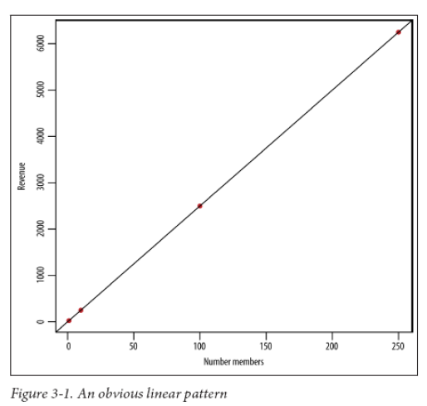
Let’s plot the data
The figure adapt from book of “Doing Data Science” Chapter 3

Slide 8
More realistic example
Example 2: housing prices
Y=House price
($1000)
Supervised Learning
Given the “right answer” for each example in the data. (given a size of a house, get a price prediction)
X=House size (feet sq.)
Regression Problem
Predict real-valued output

Slide 9
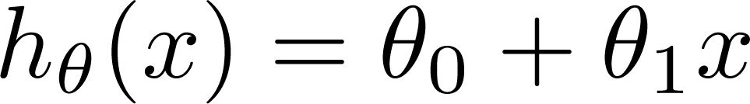
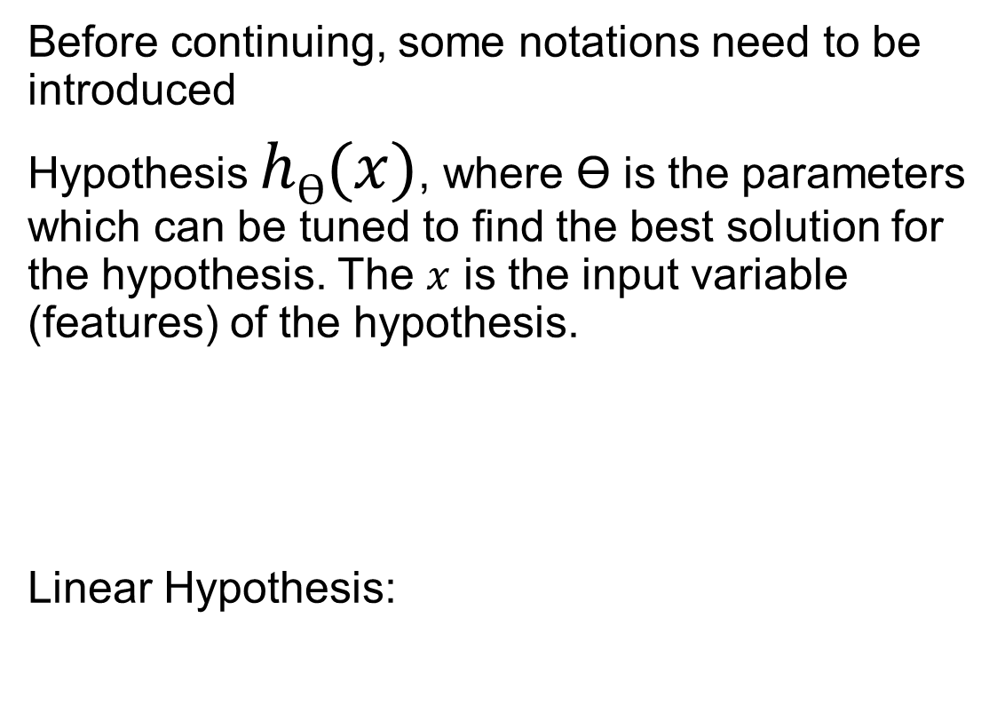
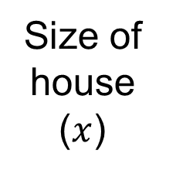
Mathematic notations
Before continuing, some notations need to be introduced
Hypothesis $hƟ(x)$, where Ɵ is the parameters which can be tuned to find the best solution for the hypothesis. The $x$ is the input variable (features) of the hypothesis.
Linear Hypothesis:
Size of house
($x$)
h
Estimate price

Slide 10

Mathematic notations
Some other notations also use simplified version
$$y=β0+β1χ$$
Each step of the prediction output use ŷ instead of $hƟ(x)$
Size in feet² (x) | Price ($) in 1000's (y)
2104 | 460
1416 | 232
1534 | 315
852 | 178
… | …
We use “m” to denote the number of training examples
1
m

Slide 11
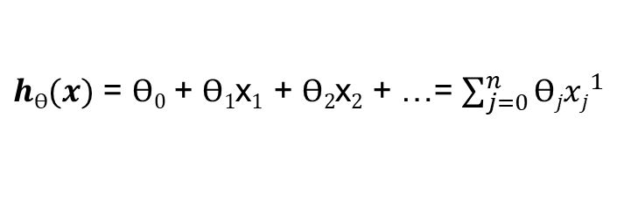
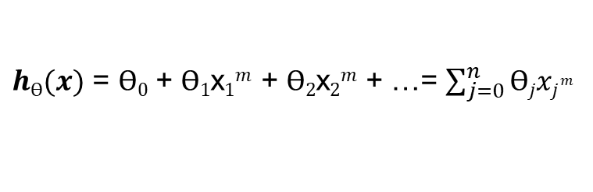
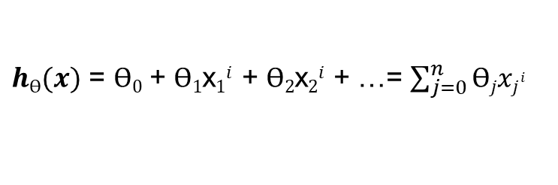

Mathematic notations
If we have more than one variables, then the hypothesis becomes to:
ŷ $=β0+β1χ1+β2χ2$
Using n to denote the # variables
Size in feet² (x₁) | # Rooms (x₂) | Price ($) in 1000's (y)
2104 | 6 | 460
1416 | 4 | 232
1534 | 5 | 315
852 | 3 | 178
… |  | …
$hƟ(x)$ = $Ɵ0$ + $Ɵ1$x$1$ + $Ɵ2$x$2$ + …= $\sum_{j=0}^{n}{{Ɵjxj}^{1}}$
…
1
$hƟ(x)$ = $Ɵ0$ + $Ɵ1$x$1i$ + $Ɵ2$x$2i$ + …= $\sum_{j=0}^{n}{{Ɵjxj}^{i}}$
…
m
$hƟ(x)$ = $Ɵ0$ + $Ɵ1$x$1m$ + $Ɵ2$x$2m$ + …= $\sum_{j=0}^{n}{{Ɵjxj}^{m}}$
i = [1,m]

Slide 12

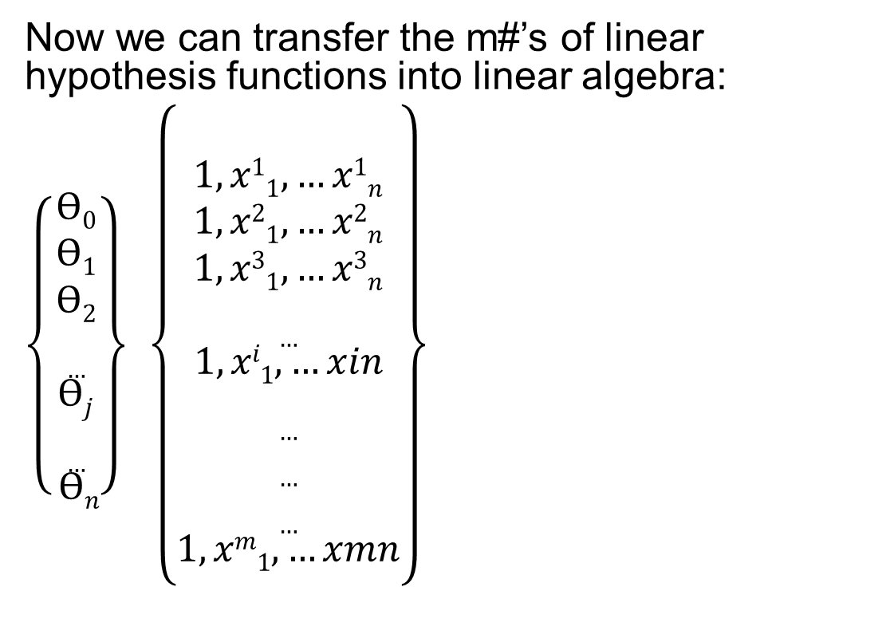


Mathematic notations
Now we can transfer the m#’s of linear hypothesis functions into linear algebra:
$\left\{\begin{aligned}Ɵ0 \\ Ɵ1 \\ Ɵ2 \\ … \\ Ɵj \\ … \\ Ɵn\end{aligned}\right\}$ $\left\{\begin{aligned}\begin{aligned} \\ 1,x11, …x1n \\ 1,x21, …x2n \\ 1, x31, …x3n \\ … \\ 1,xi1, …xin \\ … \\ … \\ … \\ 1,xm1, …xmn\end{aligned} \\ \end{aligned}\right\}$
$$ƟT$$
? $Ɵ$
Most close $hƟ\left(x\right)$ - y

Slide 13
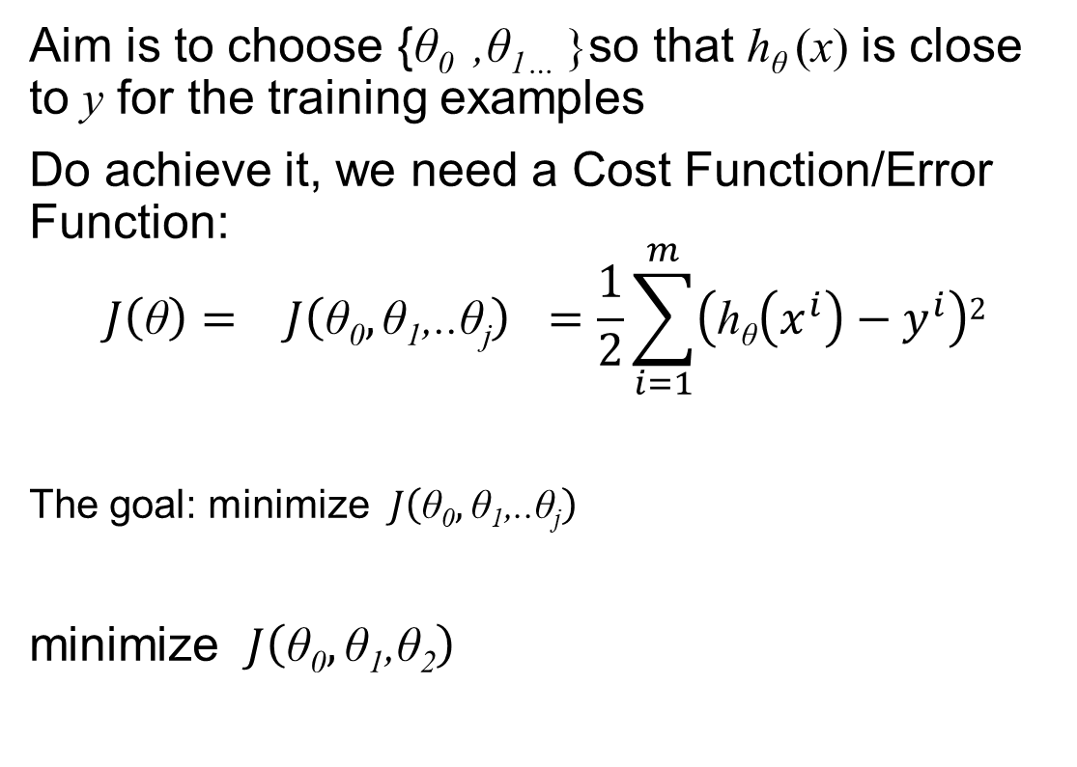
Measure “close”
Aim is to choose {θ₀ ,θ_{1…} }so that h_{θ} (x) is close to y for the training examples
Do achieve it, we need a Cost Function/Error Function:
$${J\left(\text{θ}\right)=}^{}{J\left(\text{θ}\text{0},\text{θ}\text{1}\text{,..}\text{θ}\text{j}\right)}^{}=\frac{1}{2}\sum_{i=1}^{m}{\left(\text{h}\text{θ}\left(x^{i}\right)−y^{i}\right)2}$$
The goal: minimize $J\left(\text{θ}\text{0},\text{θ}\text{1}\text{,..}\text{θ}\text{j}\right)$
minimize $J\left(\text{θ}\text{0},\text{θ}\text{1}\text{,}\text{θ}\text{2}\right)$
Size in feet² (x₁) | # Rooms (x₂) | Price ($) in 1000's (y)
2104 | 6 | 460
1416 | 4 | 232
1534 | 5 | 315
852 | 3 | 178
… |  | …

Slide 14
Calculation the closest θ value with the Cost Function
Calculation steps:
  1. Start with the initial values of θ
  θ₀=0.5, θ₁ =1.2, θ₂ =2.0 (randomly)
  2. Follow a minimizing path to keep changing θ for reducing the cost function J
  3. Stop if the J can’t be reduced anymore

Slide 15
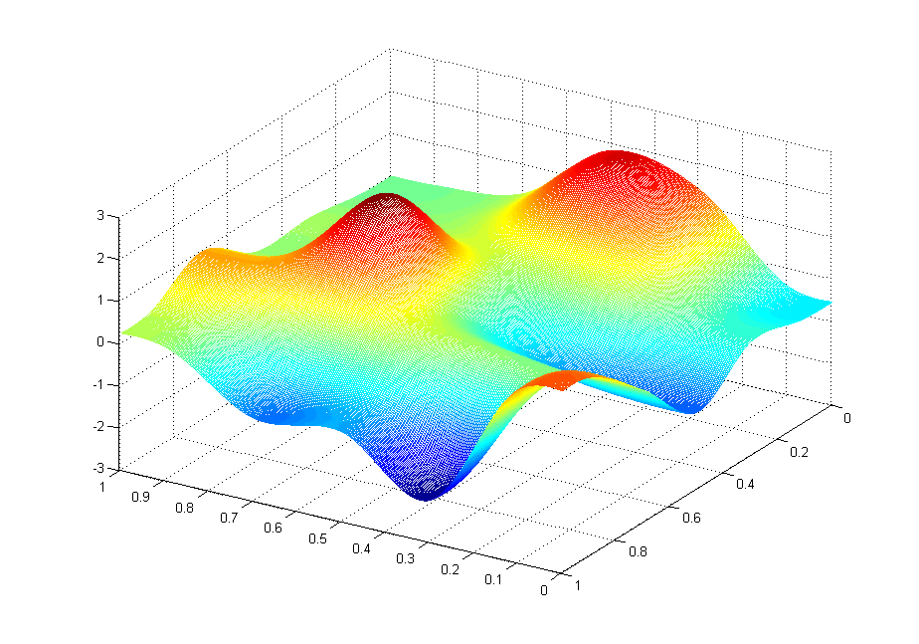
J(θ₀,θ₁)
θ₁
θ₀

Slide 16
J(θ₀,θ₁)
θ₁
θ₀

Slide 17
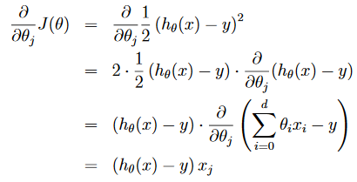


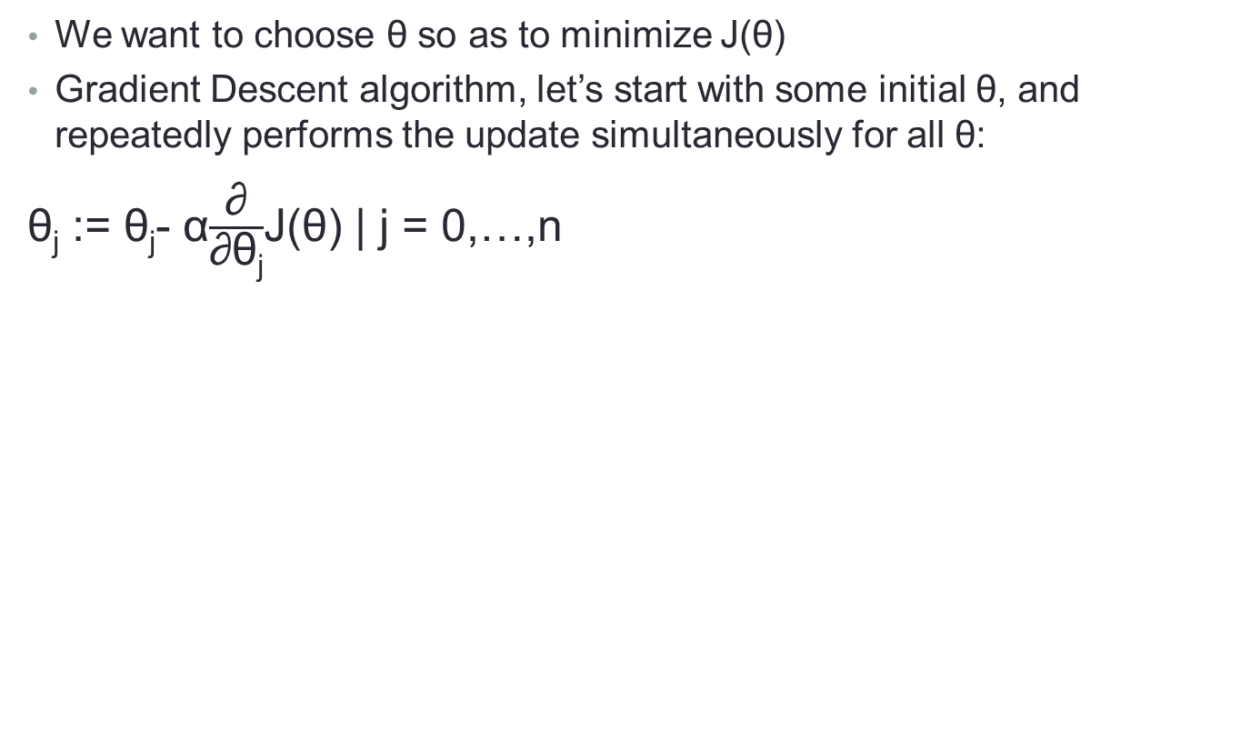
LMS (least mean squares)
We want to choose θ so as to minimize J(θ)
Gradient Descent algorithm, let’s start with some initial θ, and repeatedly performs the update simultaneously for all θ:
θ_{j} := θ_{j}- α$\frac{\text{∂}}{\text{∂}\text{θ}\text{j}}$J(θ) | j = 0,…,n
One training example (x, y)
learning rate
Partial derivative
Derivatives power rule:
Derivatives chain rule: the derivative of f(g(x)) = f'(g(x))g'(x)
For a single training example, this gives the update rule
Notes:
Click on 3rd animation script: Let’s first work it out for the case of if we have only one training example (x, y), so that we can neglect the sum in the definition of J

Slide 18

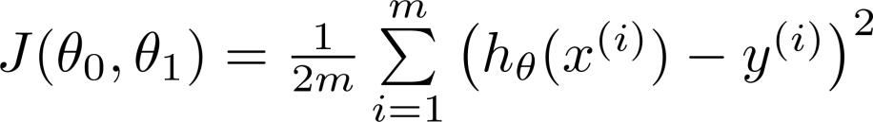
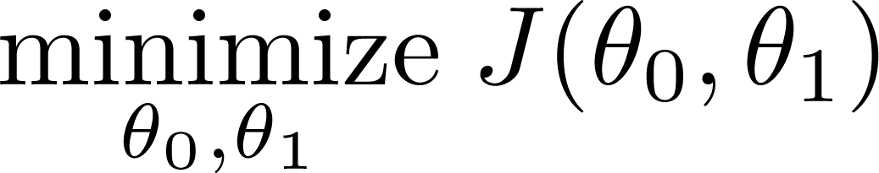
Gradient descent algorithm in example
To simplify the explanation and visualisation, we delete the #room feature from the training dataset.
Size in feet² (x) | Price ($) in 1000's (y)
2104 | 460
1416 | 232
1534 | 315
852 | 178
… | …
Hypothesis:
1
Parameters:
Cost Function:
m
Goal:

Slide 19
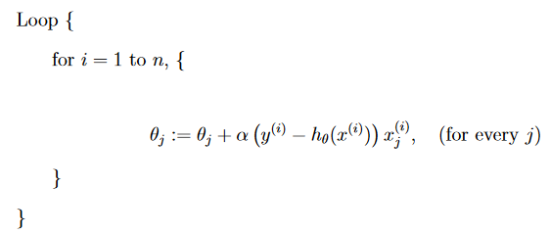
Gradient descent algorithm in code

Slide 20
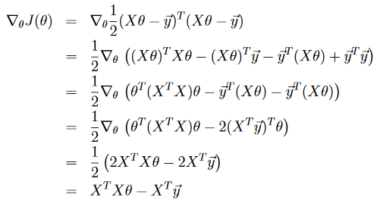
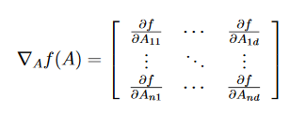
Alternative way to minimisation J
Matrix derivatives + Least squares revisited
Minimize J by explicitly taking its derivatives with respect to the θj’s, and setting them to zero

Slide 21

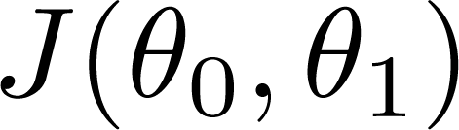


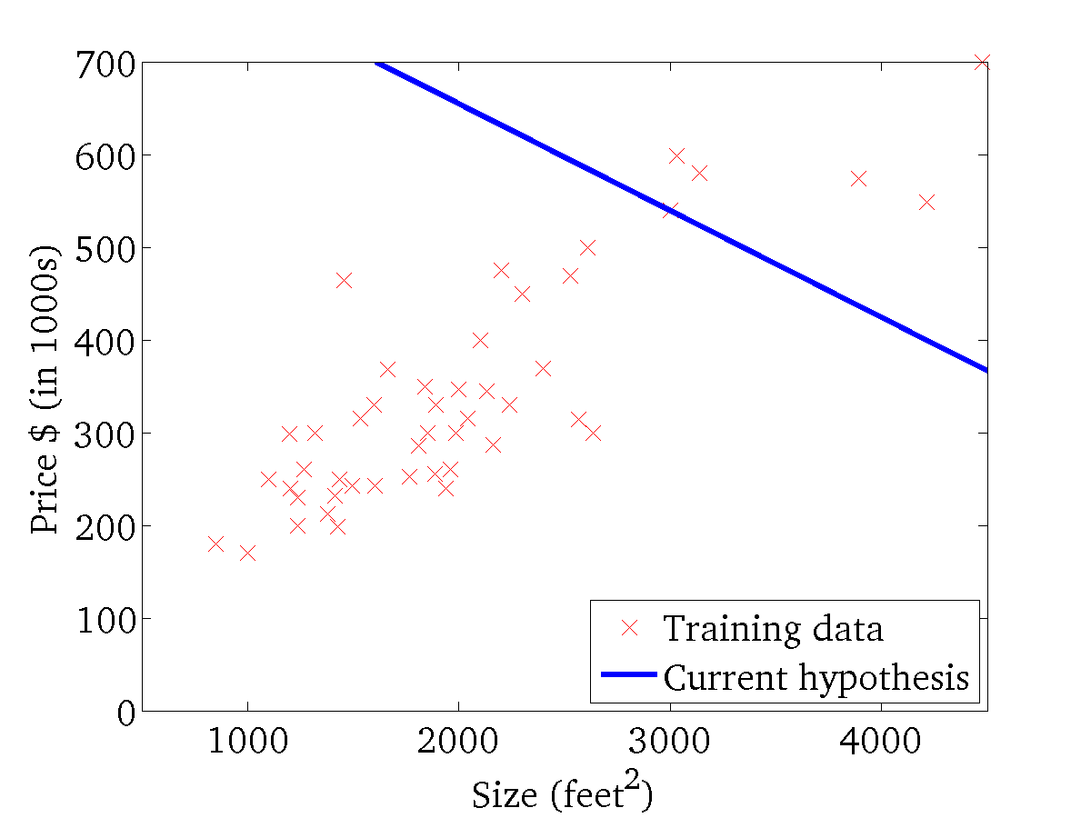
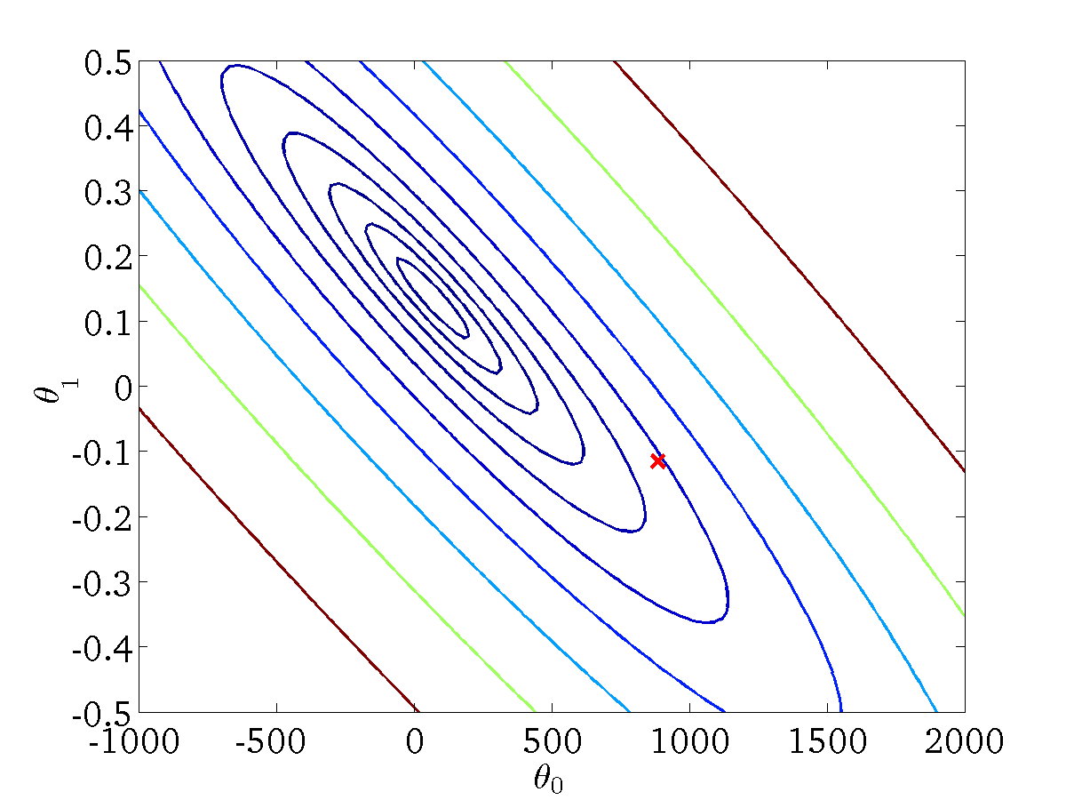
Gradient descent visualisation
(for fixed , this is a function of x)
(function of the parameters )

Slide 22
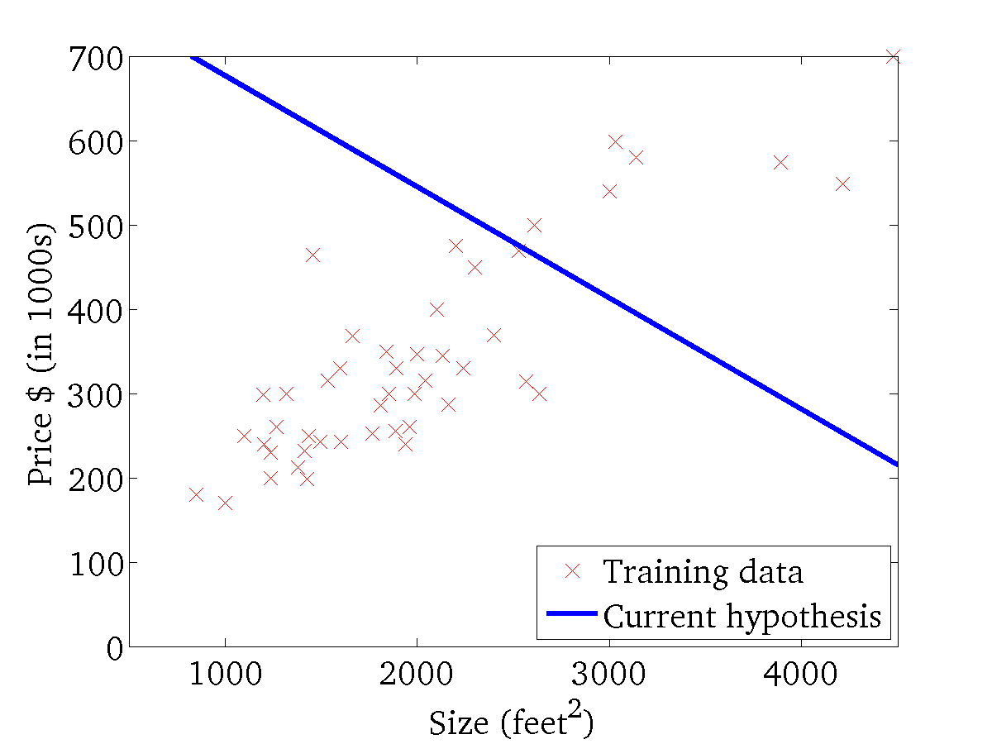

(for fixed , this is a function of x)
(function of the parameters )

Slide 23
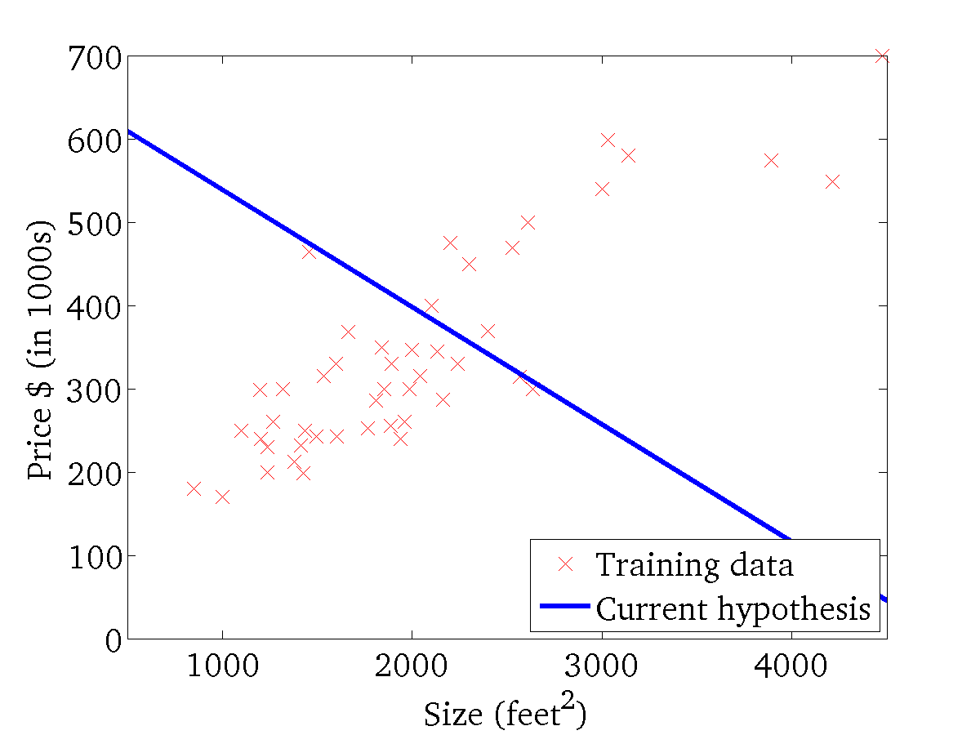
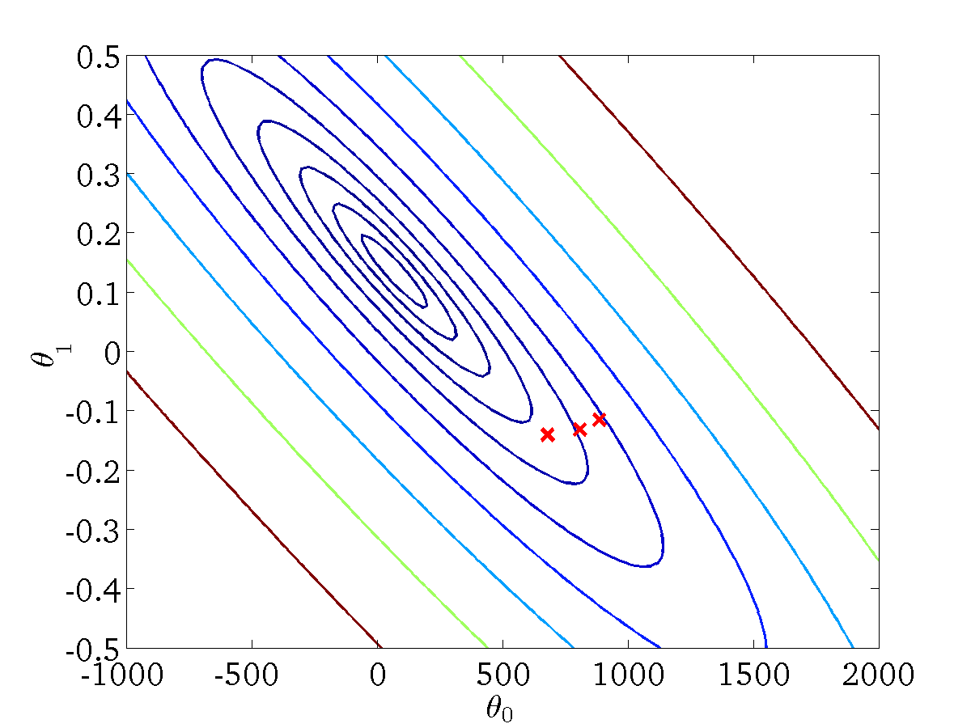
(for fixed , this is a function of x)
(function of the parameters )

Slide 24
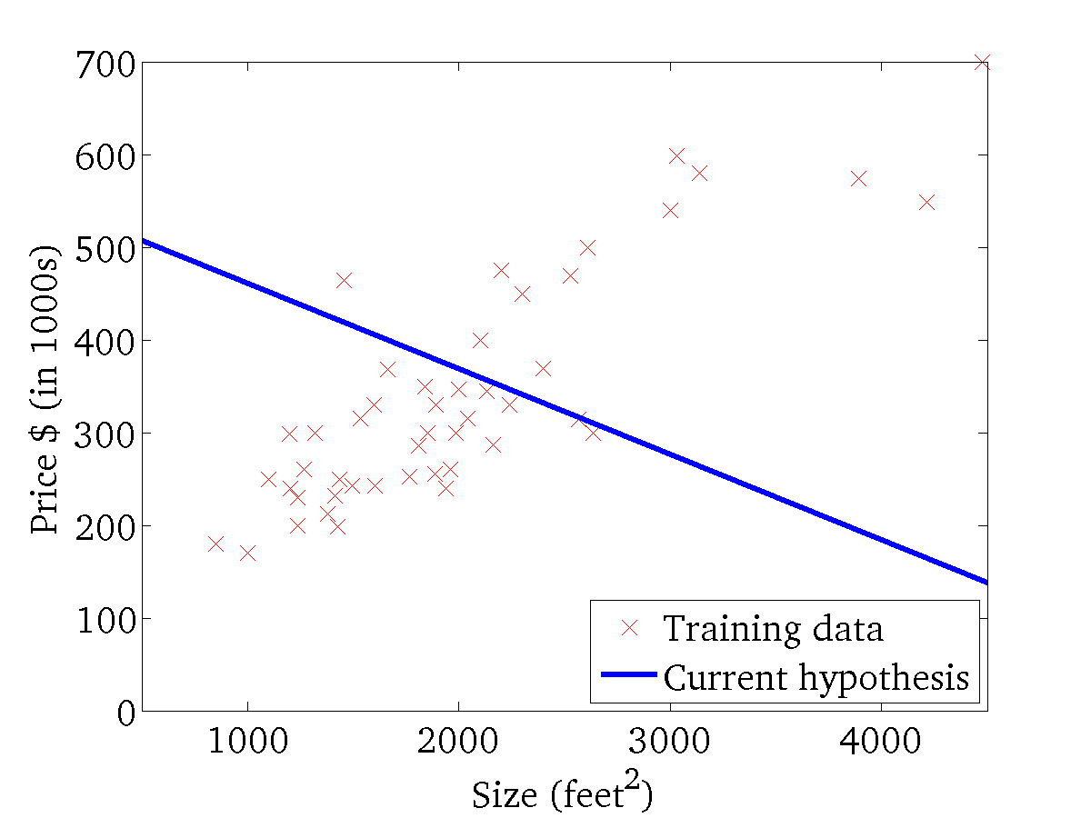

(for fixed , this is a function of x)
(function of the parameters )

Slide 25
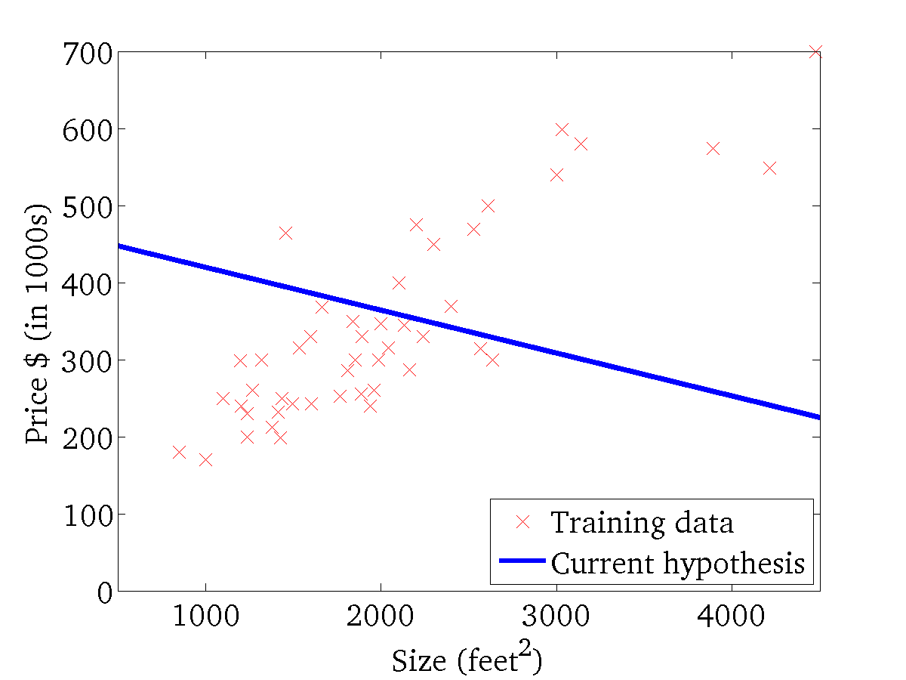
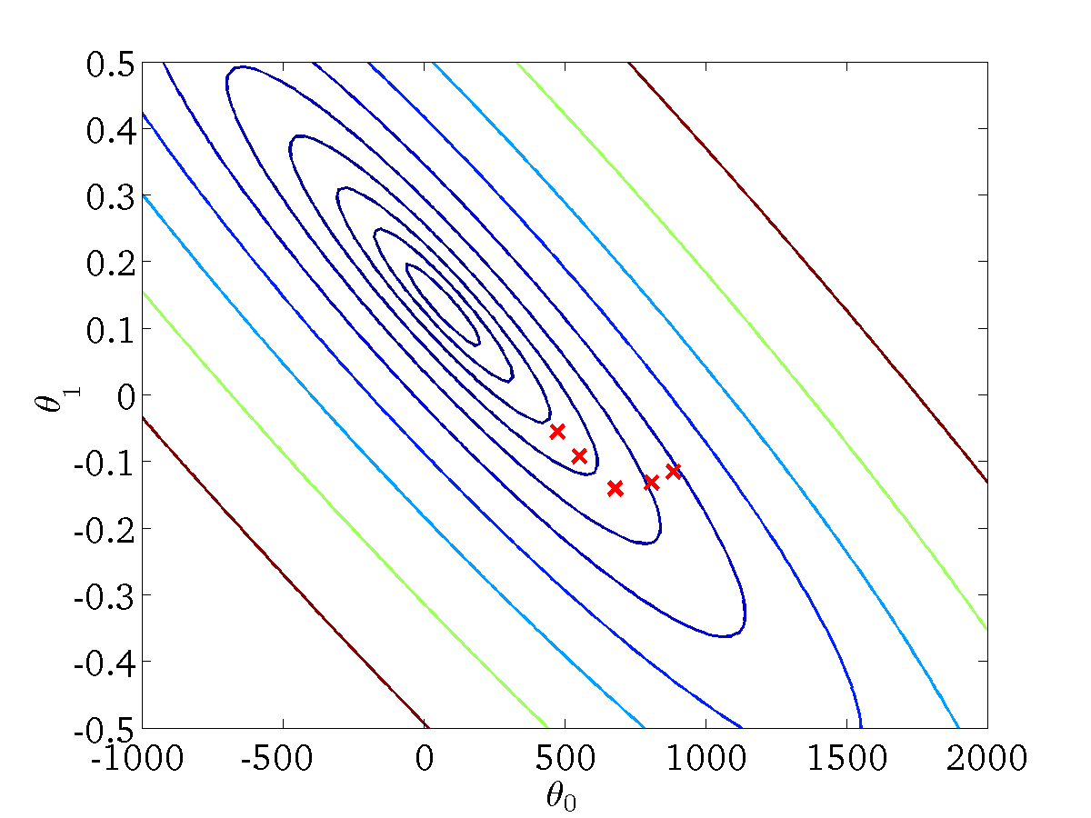
(for fixed , this is a function of x)
(function of the parameters )

Slide 26
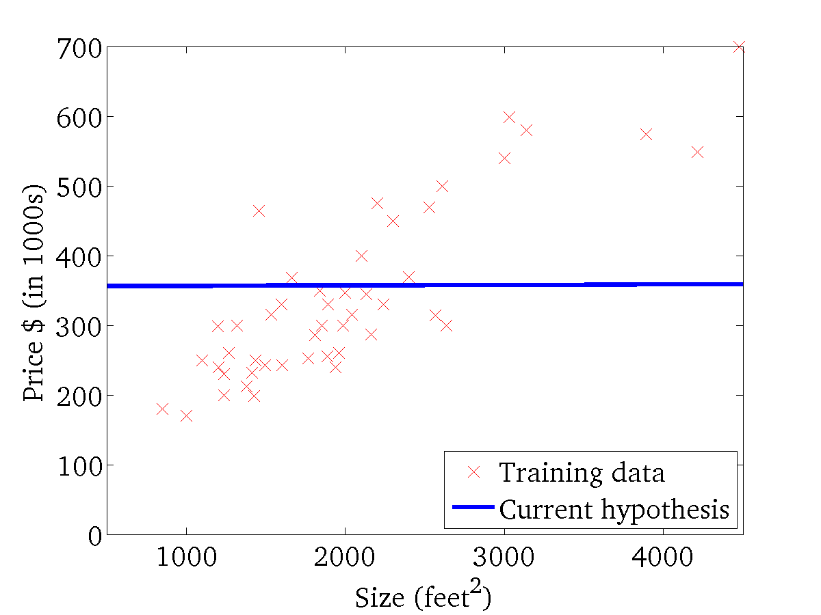

(for fixed , this is a function of x)
(function of the parameters )

Slide 27
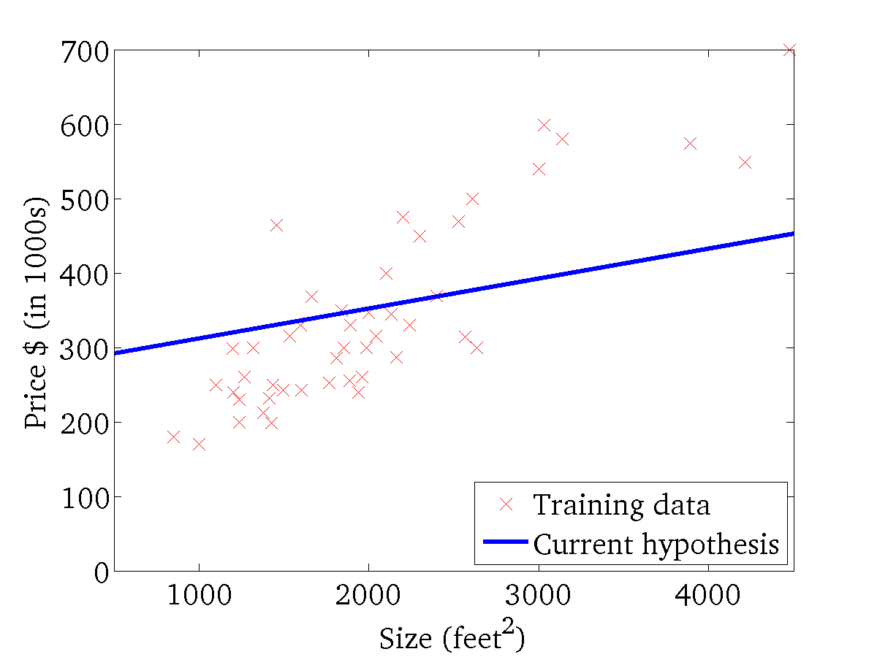

(for fixed , this is a function of x)
(function of the parameters )

Slide 28
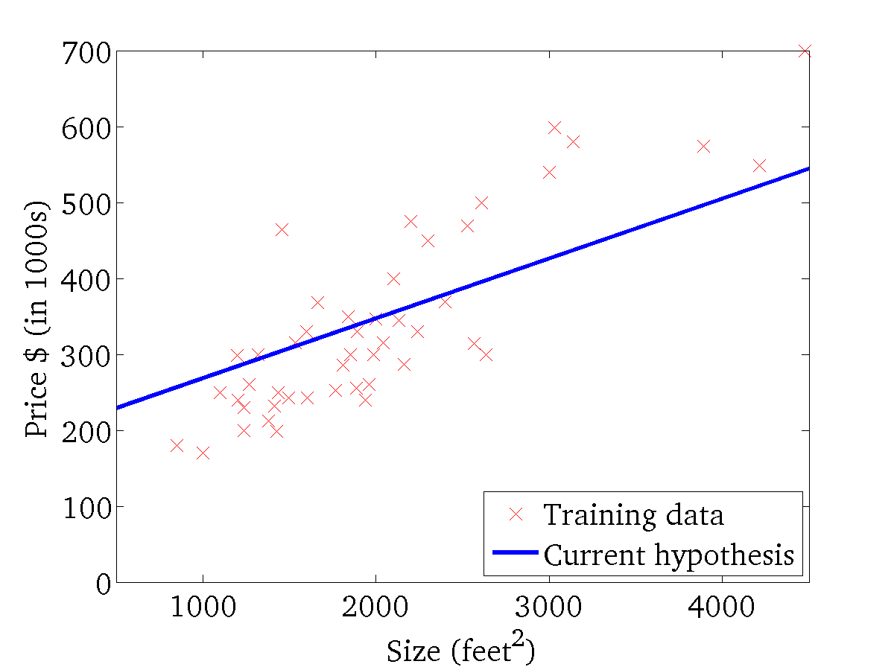
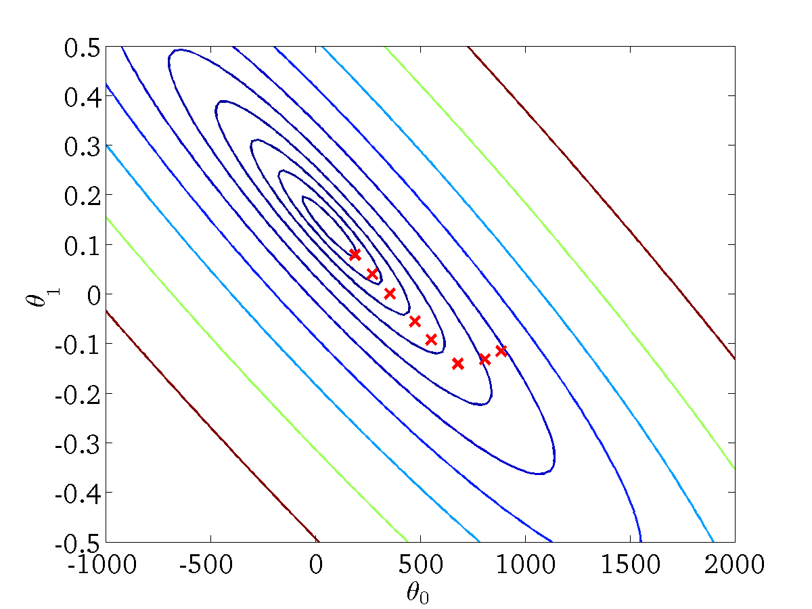
(for fixed , this is a function of x)
(function of the parameters )

Slide 29
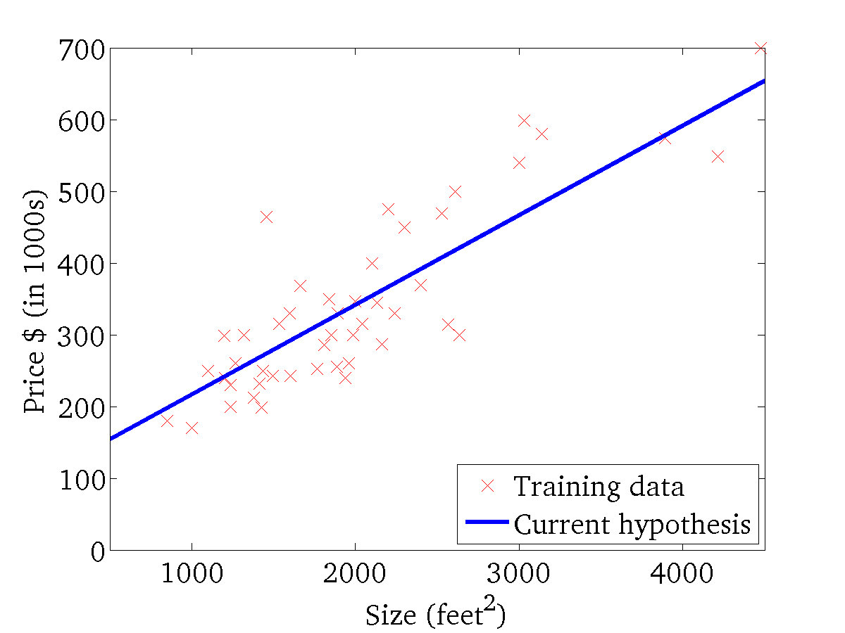

(for fixed , this is a function of x)
(function of the parameters )

Slide 30
“Batch” Gradient Descent
“Batch”: Each step of gradient descent uses all the training examples.
Alternative: process part of the dataset for each step of the algorithm.

Slide 31





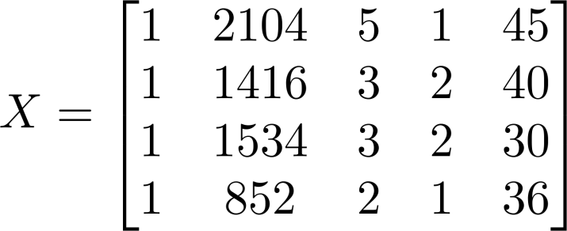
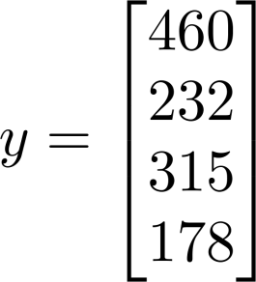
The multiple features
 | Size (feet²) | #bedrooms | # floors | Age of home (years) | Price ($1000)
1 | 2104 | 5 | 1 | 45 | 460
1 | 1416 | 3 | 2 | 40 | 232
1 | 1534 | 3 | 2 | 30 | 315
1 | 852 | 2 | 1 | 36 | 178
n=4

Slide 32


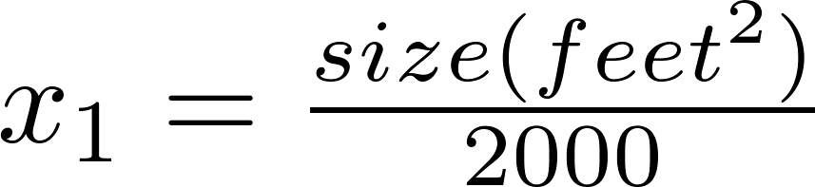
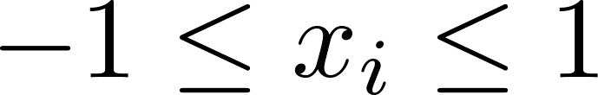
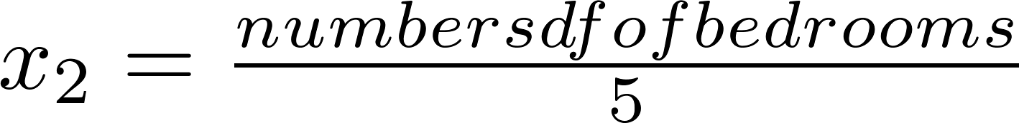
Feature Scaling
Idea: Make sure features are on a similar scale.
E.g. = size (0-2000 feet²)
= number of bedrooms (1-5)
size (feet²)
Get every feature into range
number of bedrooms

Slide 33



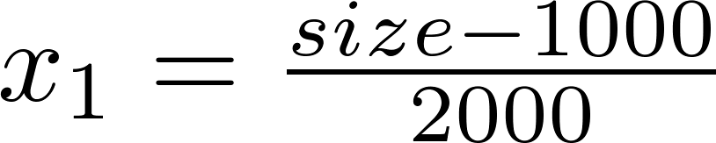
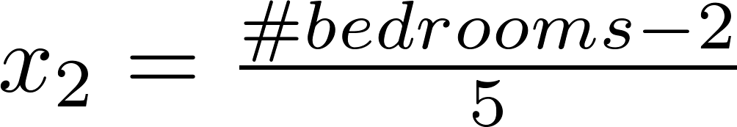
Feature Scaling
Idea: Make sure features are on a similar scale.
E.g. = size (0-2000 feet²)
= number of bedrooms (1-5)
Replace with to make features
have approximately zero mean
(Do not apply to ).
Mean normalization
E.g.

Slide 34
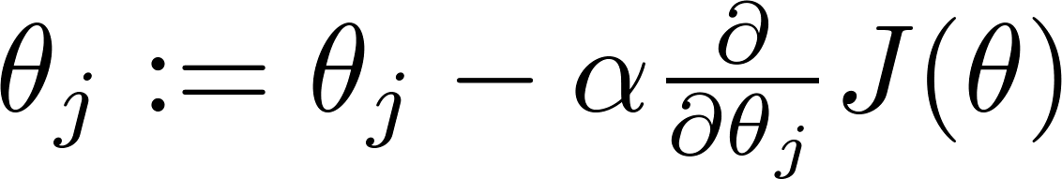

Gradient descent
“Debugging”: How to make sure gradient descent is working correctly.
How to choose learning rate .

Slide 35

Choosing
If is too small: slow convergence.
If is too large: may not decrease on every iteration; may not converge.
To choose , try

Slide 36
Outlook
Linear regression
  Examples
  Math notation
  Least Mean Square function (LMS)
  Gradient Descent function
Logistic regression

Slide 37
Logistic Regression
Logistic Regression (LR) is a model (algorithm) used to solve a classification problem.
Especially, LR aims to binary classification problem that means the target class y = {0,1}.
The reason LR is still a regression model because it’s underlying techniques is very close to Linear Regression.
The term logistic is taken purely because the Logit Function is used to do the classification.

Slide 38
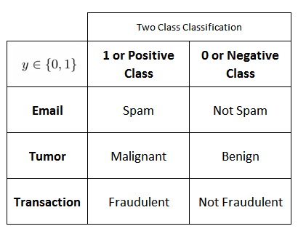
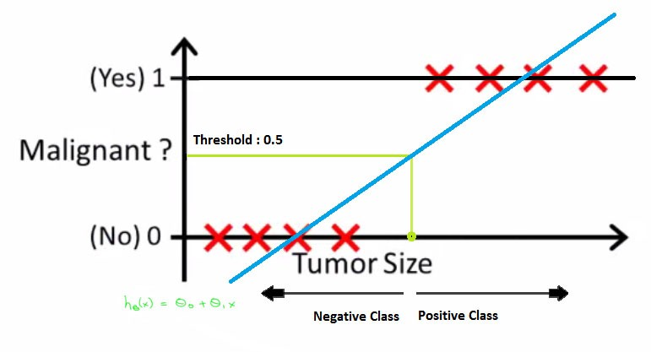
Binary Classification problem examples
Why cannot use Linear Regression?
Notes:
We identify problem as classification problem when independent variables are continuous in nature and dependent variable is in categorical form i.e. in classes like positive class and negative class. The real life example of classification example would be, to categorize the mail as spam or not spam, to categorize the tumor as malignant or benign and to categorize the transaction as fraudulent or genuine. All these problem’s answers are in categorical form i.e. Yes or No. and that is why they are two class classification problems.
Suppose we have a data of tumor size vs its malignancy. As it is a classification problem, if we plot, we can see, all the values will lie on 0 and 1. And if we fit best found regression line, by assuming the threshold at 0.5, we can do line pretty reasonable job
Although, sometime we come across more than 2 classes and still it is a classification problem. These types of problems are known as multi class classification problems.

Slide 39
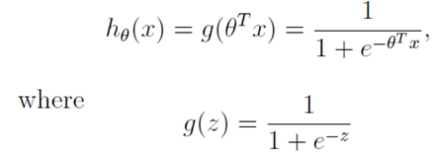
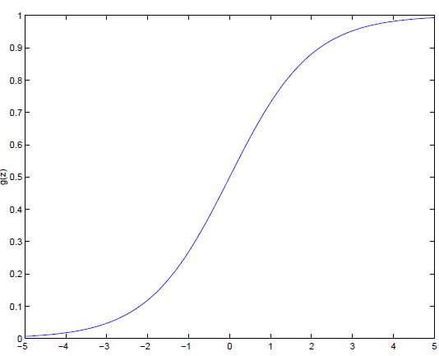

Logistic Regression model
The logistic function is a Sigmoid function, which takes any real value between zero and one. So the logistic regression hypothesis is defined as:
g(z) tends towards 1 as z → ∞
g(z) tends towards 0 as z → −∞.

Slide 40
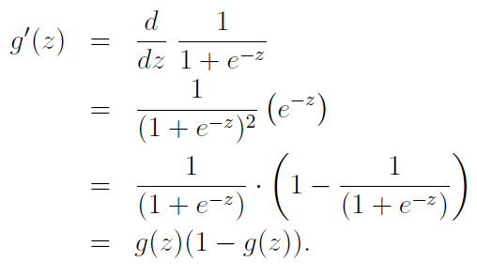

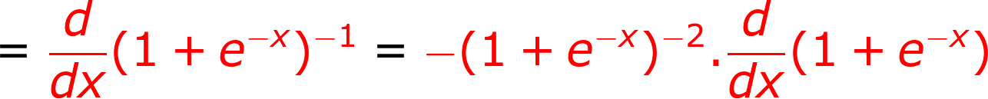




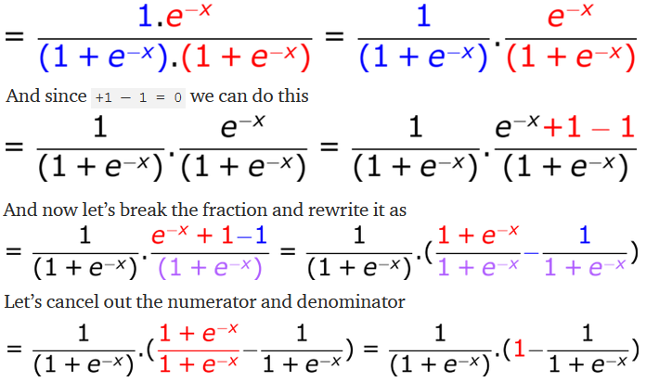


Important property
Before moving on, here’s a useful property of the derivative of the sigmoid function, which we write as g′:
Reciprocal rule:
Linearity rule:
)
Exponential rule:
z=x
Linearity rule:
z=x

Slide 41
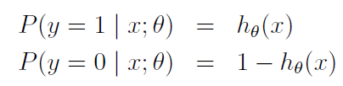

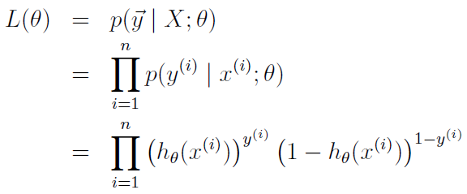
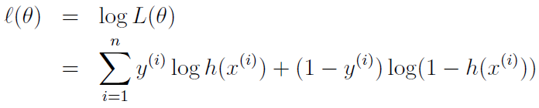
Search for θ
Given the logistic regression model, how do we fit θ for it?
Probabilistic assumptions
Notes:
So, given the logistic regression model, how do we fit θ for it? Following
how we saw least squares regression could be derived as the maximum like-
lihood estimator under a set of assumptions, let’s endow our classification
model with a set of probabilistic assumptions, and then fit the parameters
via maximum likelihood.
Assuming that the n training examples were generated independently, we
can then write down the likelihood of the parameters as L(sita)

Slide 42


Search for θ (cont.)
Gradient ascent rule:
The identical update rule for linear regression
Notes:
If we compare this to the LMS update rule, we see that it looks identical; but
this is not the same algorithm, because h(x(i)) is now defined as a non-linear
function of θT x(i). Nonetheless, it’s a little surprising that we end up with
the same update rule for a rather different algorithm and learning problem.

Slide 43


Logistic Regression Python

Slide 44


Evaluation

Slide 45
Summary
The linear regression (definition and examples)
Linear and Logistic regression process and math foundations
  Math notations, LMS, Gradient Descent algorithm
Make sure your linear regression works correctly
  Scaling (normalisation), and select learning rate

